Slide 1

Back Testing On TQQQ
Sterling Hayden
Notes:
Sebastian

Slide 2
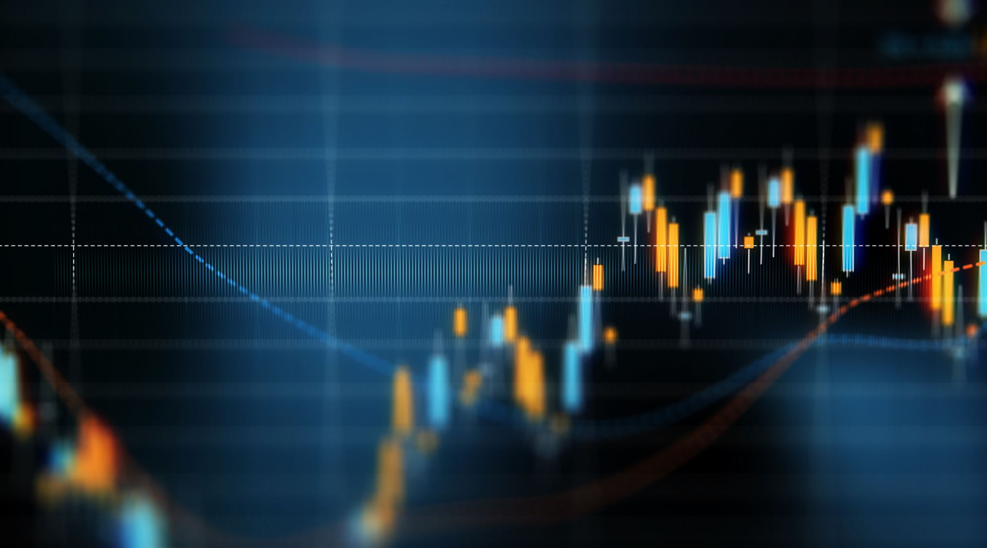
Central Question: Is it possible to accumulate wealth over long term periods by holding leveraged ETFs like TQQQ?
Notes:
Sebastian
Considering that the average annual stock market return is approximately 10%, one could reasonably contemplate utilizing leverage to target a 3x return. However, it's essential to acknowledge the potential risks involved and weigh them against the potential rewards before deciding to pursue such a strategy.

Slide 3

Necessary Background Information

Slide 4

What Is Back testing?
Notes:
Sebastian
Back testing is a technique used to evaluate the effectiveness of a trading strategy or investment approach by applying it to historical market data.
It involves simulating trades using historical data to see how the strategy would have performed in the past, and analyzing the results to determine the potential profitability and risk of the strategy.
This allows traders and investors to refine their approach and improve their decision-making processes based on past performance.

Slide 5
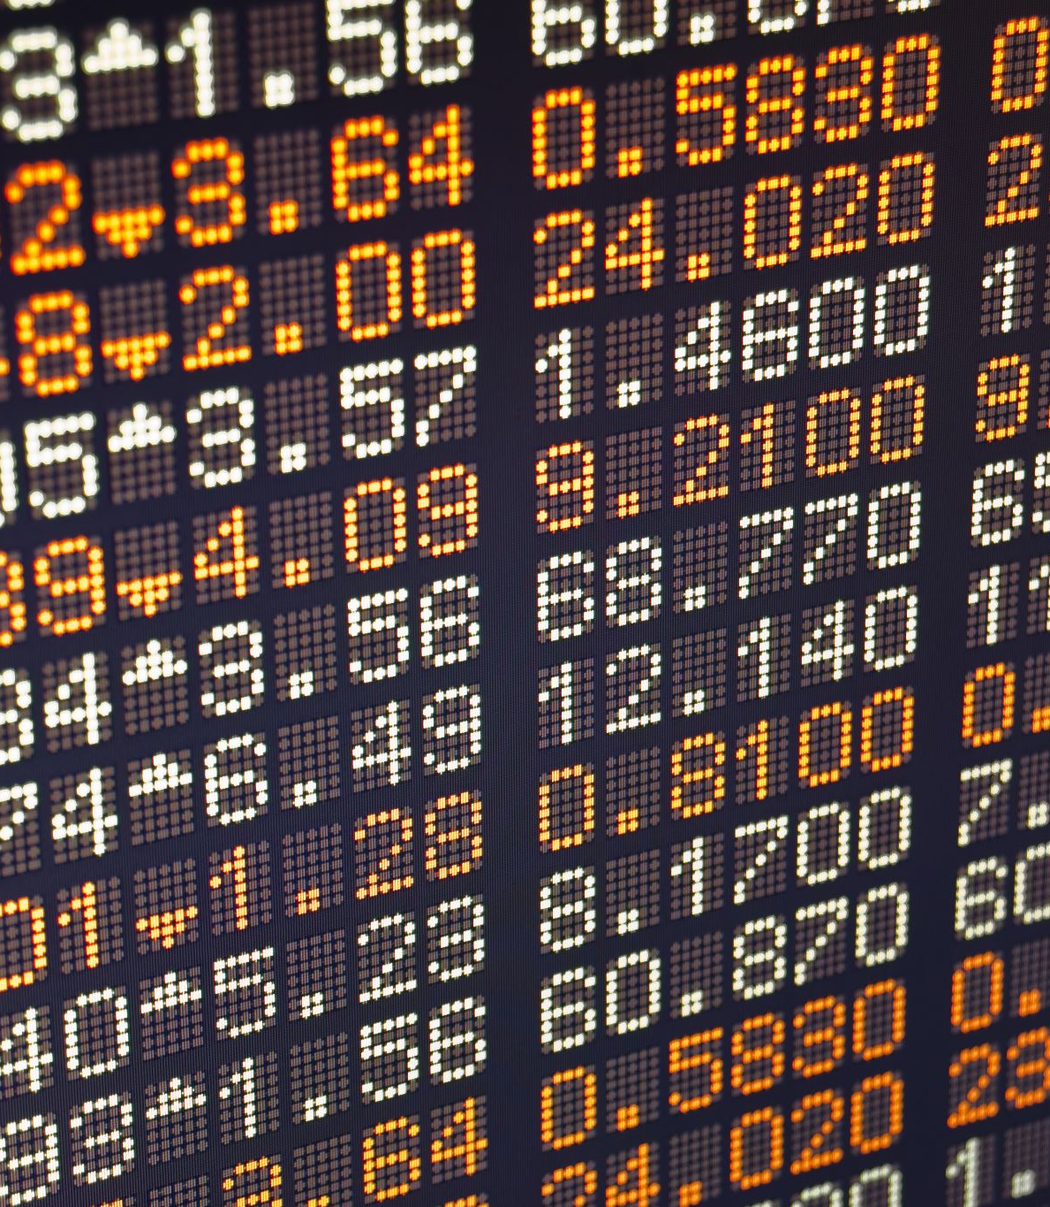
Understanding ETF’s
ETF stands for "exchange-traded fund" and is a type of investment fund that holds a basket of underlying assets such as stocks, bonds, and/or commodities
Enable easy exposure to sectors, regions, or asset classes, which generally help diversify their portfolios and mitigate risks
The most popular ETFs, such as those tracking the S&P 500 or Nasdaq 100, have a long track record of providing strong returns of ~10% annually.
Notes:
Bradly
Exchange traded fund
Allows investors to buy and sell a portfolio of assets.
Similar to mutual funds but they trade on stock exchanges and can be bought and sold throughout the trading day at market prices.
Designed to track performance of specific market index, industry, sector, or asset
Low cost compared to mutual fund

Slide 6
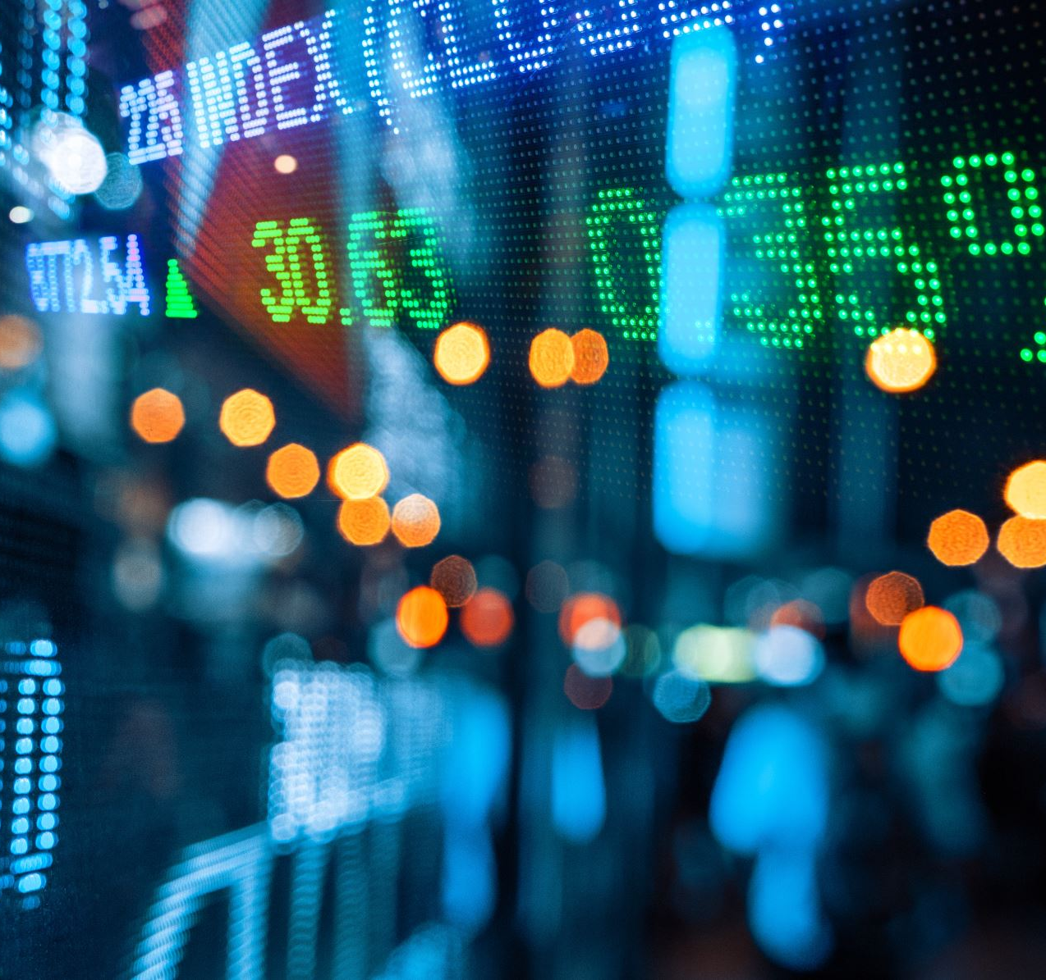
S&P 500 ETF Trust ($SPY)
SPY tracks the performance of the S&P 500 index, which includes 500 large cap U.S. companies across multiple sectors.
This fund is the largest and oldest ETF in the world, a clear indicator of strong performance.
SPY has a long-term average annual return of approximately 10%, making it a popular choice for investors seeking exposure to the broader U.S. equity market.
Notes:
Bradly
SPY was the first index exchange-traded fund listed on U.S. exchanges. One of most actively traded ETF's
It fully replicates the index of S&P 500 at price target of 10%
So, if the S&P is at a level of 4,000, then one SPY share should trade at close to $400
1/4 SPY is invested in information technology sector
It seeks to track the performance of S&P 500 index (a basket of the largest publicly traded companies)
S&P 500 main benchmark of the U.S. equity market
Indicates health and stability of economy

Slide 7
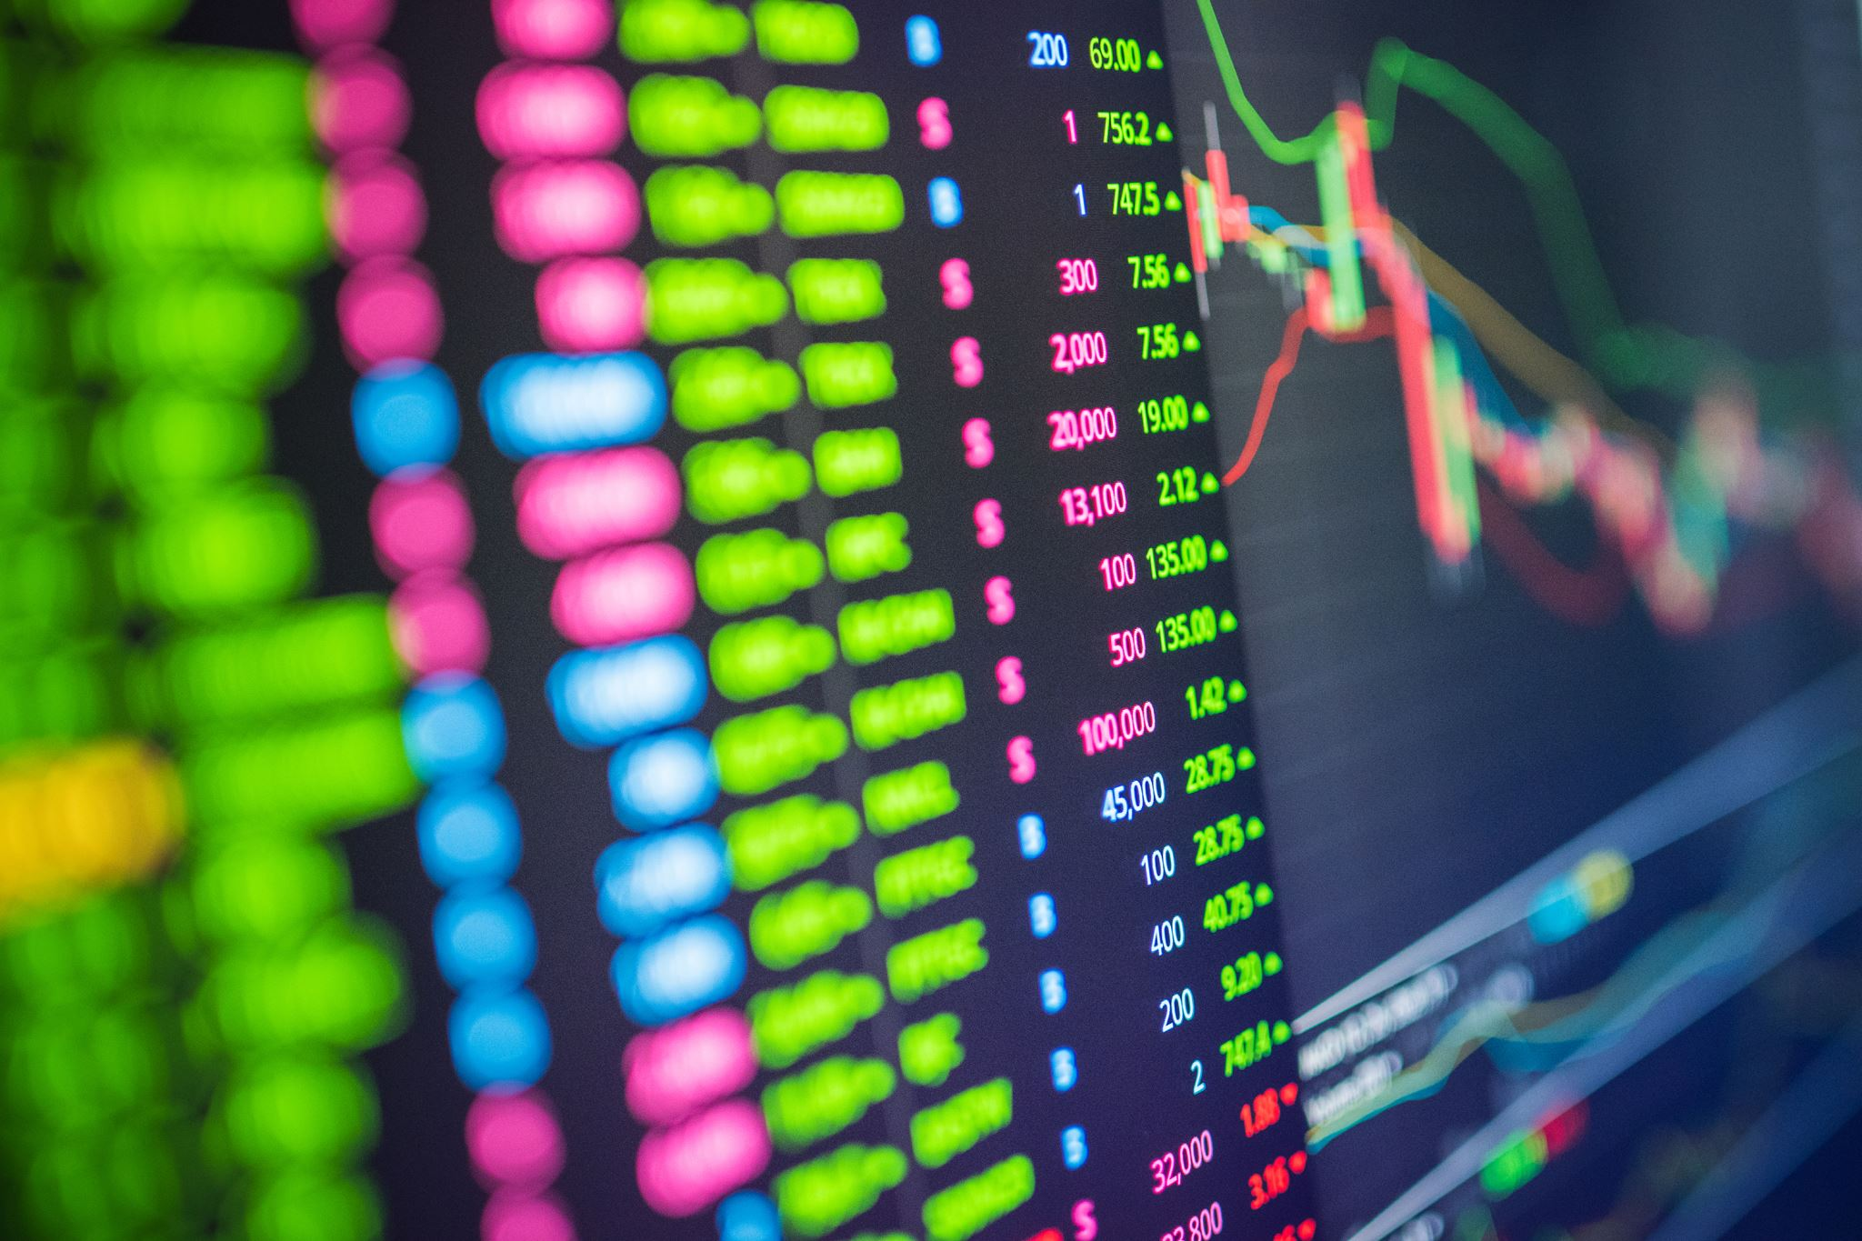
ProShares UltraPro QQQ ETF ($TQQQ)
TQQQ is an exchange-traded fund that seeks to provide triple the daily returns of the Nasdaq-100 index($QQQ)
Powerful tool for investors seeking to magnify their market exposure
Commonly used for swing trading due to greater risks, including higher volatility, higher costs, and the potential for significant losses
Notes:
walker

Slide 8
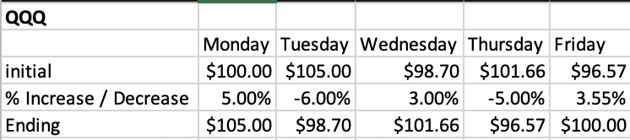
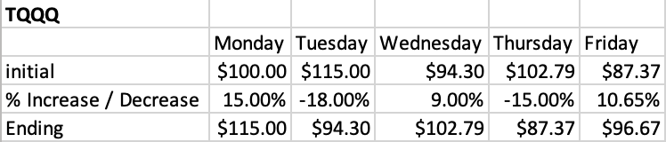
Explaining Decay
Decay is the tendency of leveraged ETFs like TQQQ to diverge from their underlying index over time due to compounding effects
Decay is more pronounced in periods of high volatility and can lead to lower total returns compared to the underlying index
Notes:
walker

Slide 9
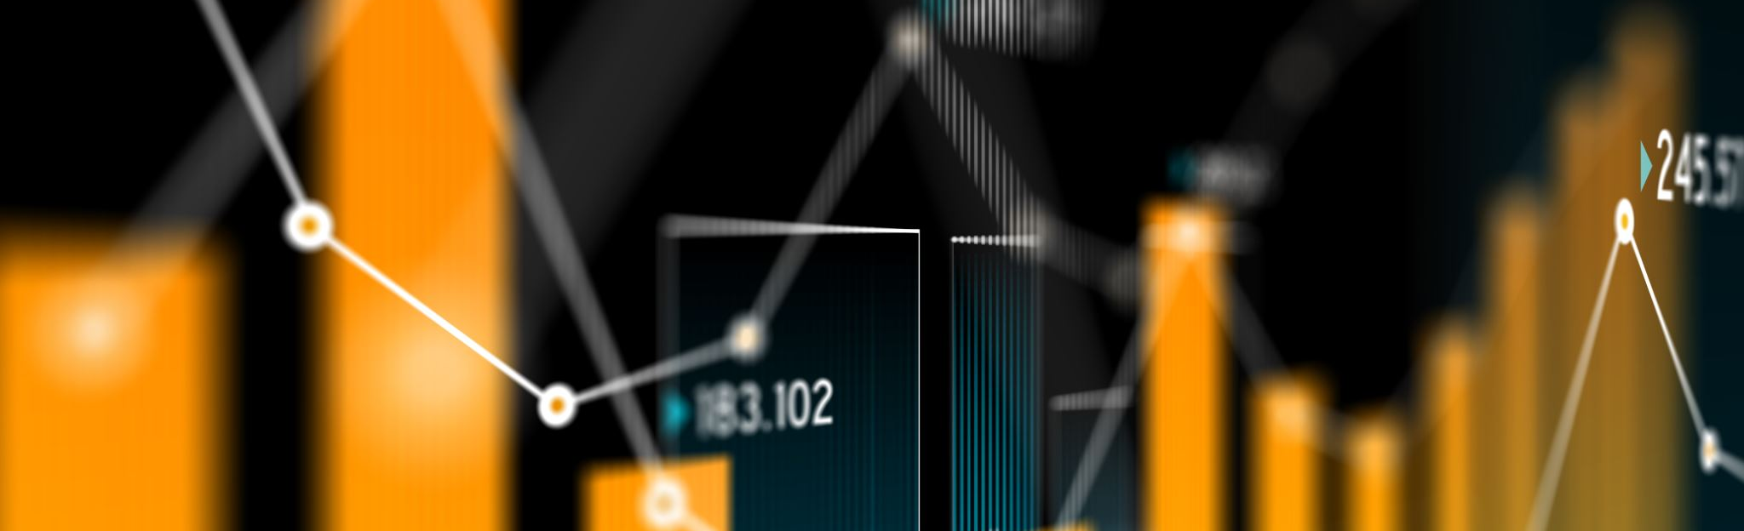
Theory Of Our Analysis
Considering that the average annual stock market return is approximately 10% annually, one could reasonably contemplate utilizing leverage to target a 3x return(30%). However, it's essential to acknowledge the potential risks involved and weigh them against the potential rewards before deciding to pursue such a strategy.
Can we achieve these high rates of return while mitigating the associated risks through portfolio diversification and constant rebalancing?

Slide 10
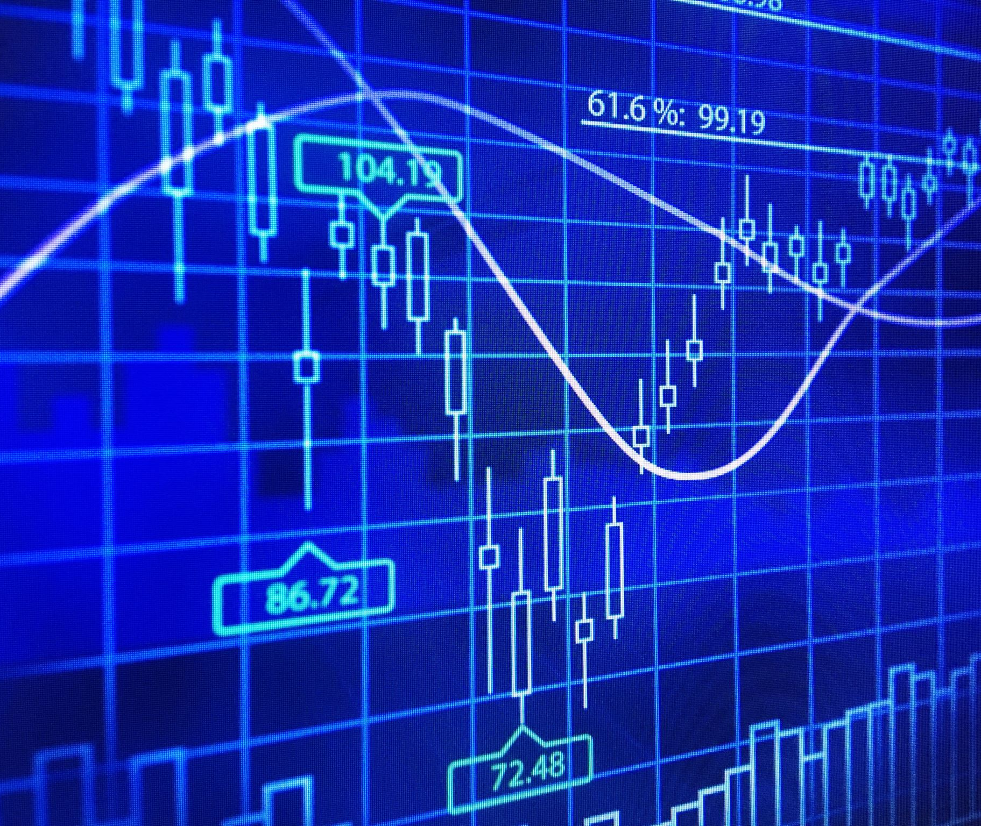
Our Analysis

Slide 11
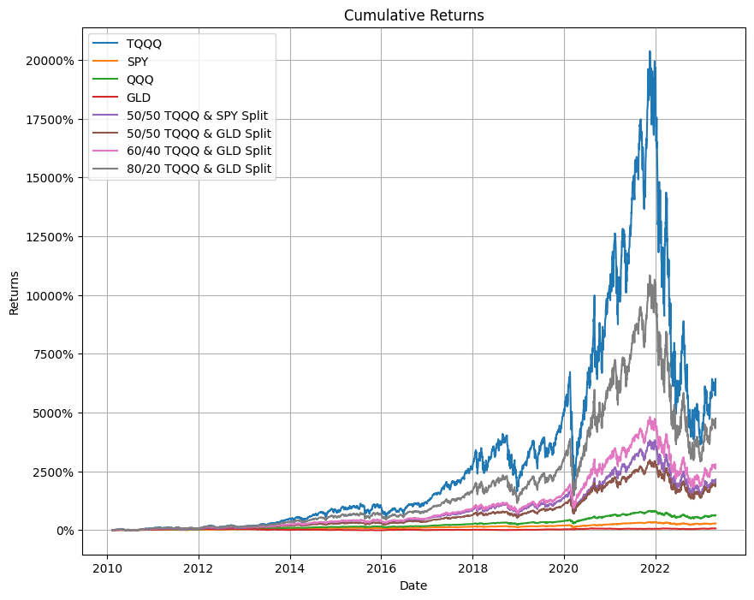
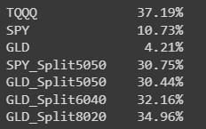
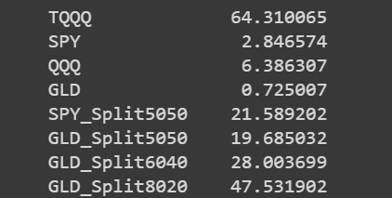
From Inception

Slide 12
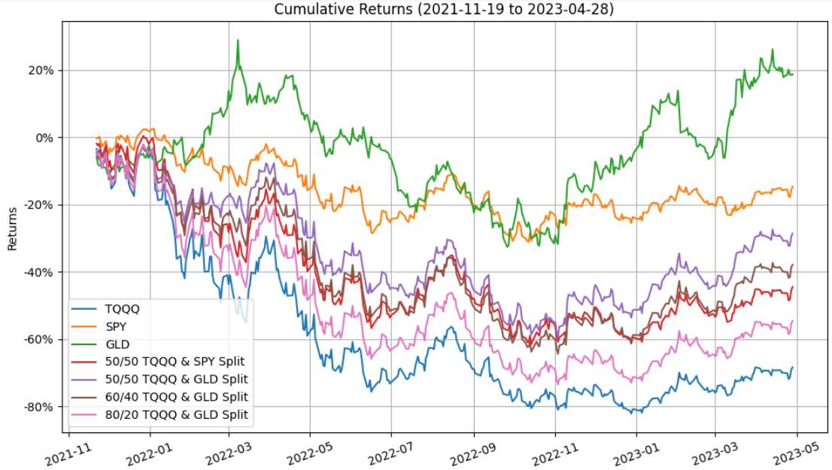
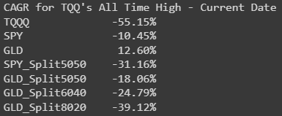
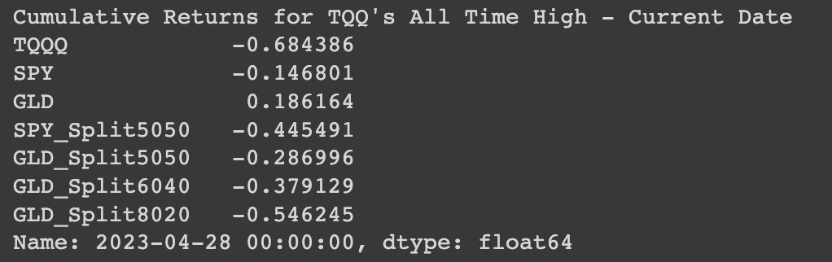
TQQQ's All Time High

Slide 13
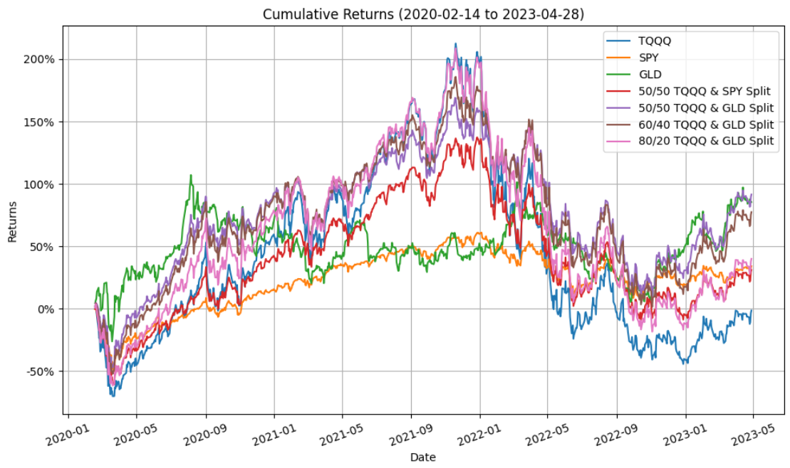
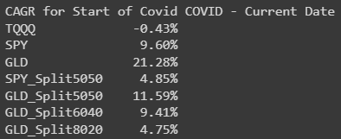
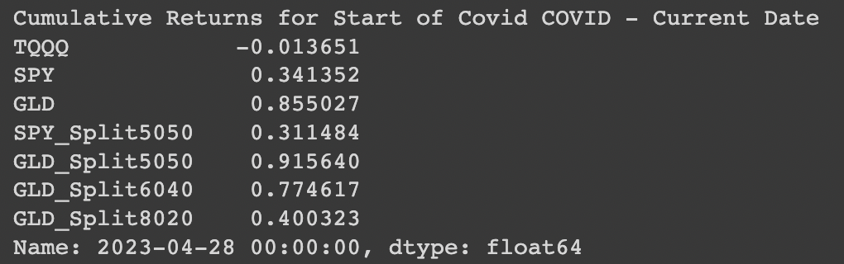
Covid Bear Market Rally

Slide 14
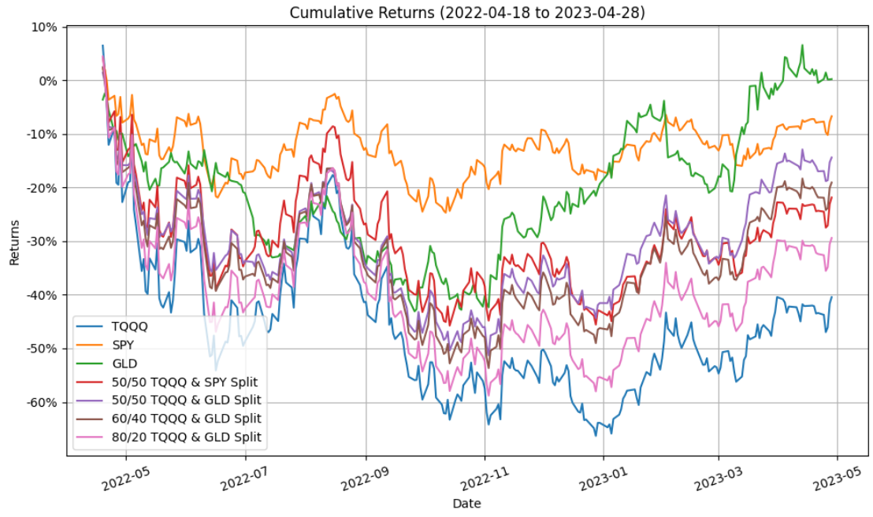
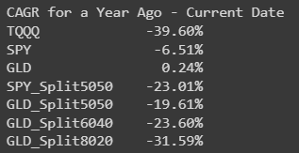
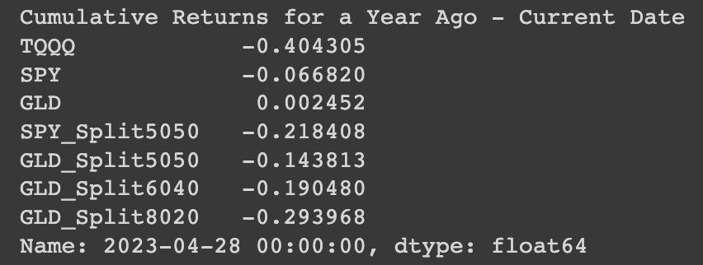
A Year Ago

Slide 15
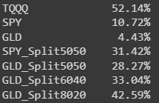
Monte Carlo Simulation

Slide 16

Conclusion
Explaining the Numbers
Investors with a high-risk tolerance may want to consider allocating a larger percentage of their portfolio or even going all in on TQQQ
Moderate risk tolerant investors may consider a balanced approach that combines exposure to TQQQ and traditional ETFs
Investors who are risk-averse may prefer to stick to traditional ETFs

Slide 17

Questions?

